Slide 1
Machine Learning for Predicting Breast Cancer Diagnosis
Joe Bater – D Det – 243 Fd Hosp
What it is
Why it’s important to you
How you

Slide 2
Content
Intro
Taxonomy of terms – AI & ML
Video #1
Neural networks & deep learning
Video #2
Wisconsin Breast Cancer Data & model results
2 min
5 min
4 min
10 min
16 min
3 min

Slide 3

What is Machine Learning?
Machine Learning is branch of the wider field of Artificial Intelligence
Branches include :
- computer vision
- natural language processing
- text analysis
- robotics
- constraint satisfaction
- machine reasoning, etc.
- philosophy
Ultimately ML is about discerning patterns in a dataset, from which we can derive value/meaning/wisdom
SUPERVISED – we teach an ML algorithm by showing it examples and associating to a correct output
UNSUPERVISED – our ML algorithms discern or discover patterns or groupings in the data

Slide 4
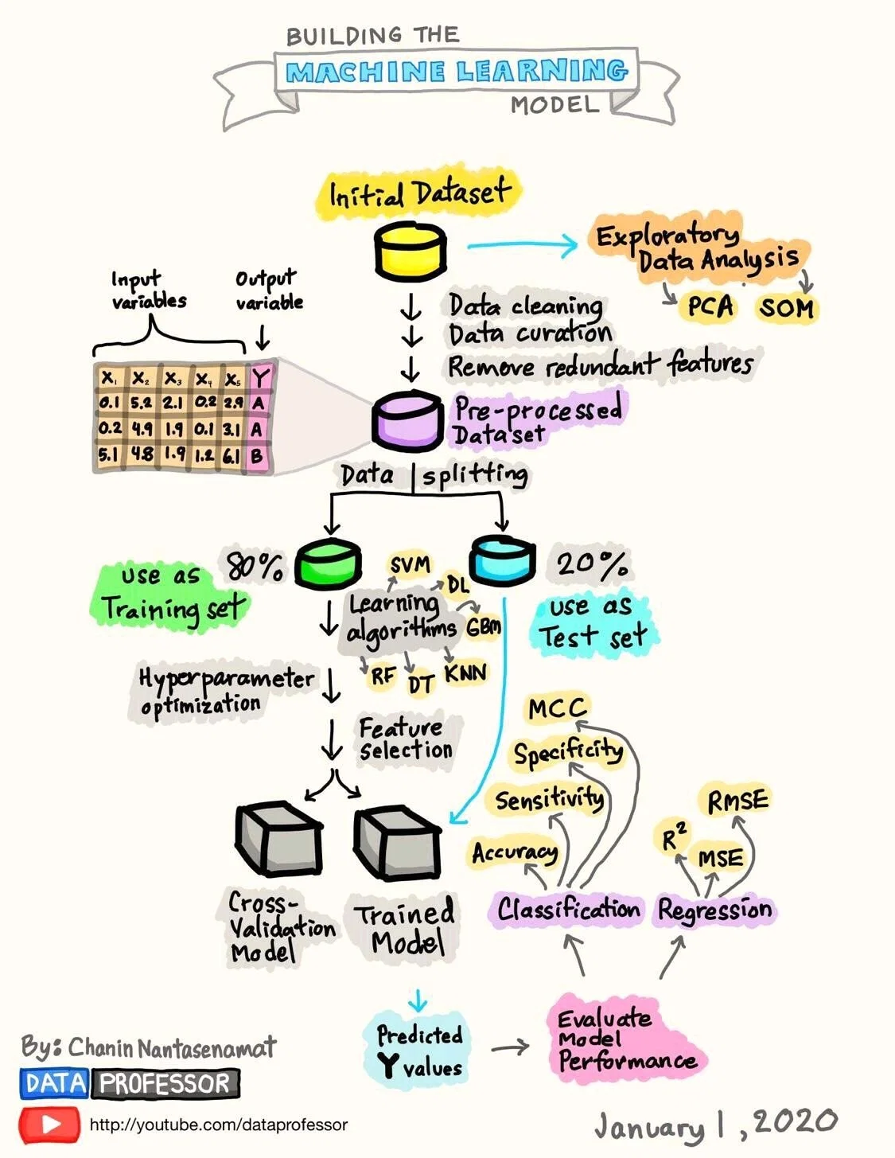
SUPERVISED
Far from exhaustive list of algorithmic approaches and paradigms!
But we’ll talk a little more about deep learning (DL) throughout this presentation

Slide 5
Video
AI in Healthcare: Top A.I. Algorithms In Healthcare - The Medical Futurist
https://www.youtube.com/watch?v=G1IsZeFR_Rk
(3min 21sec)

Slide 6
Deep Learning (Artificial Neural Networks)

Slide 7
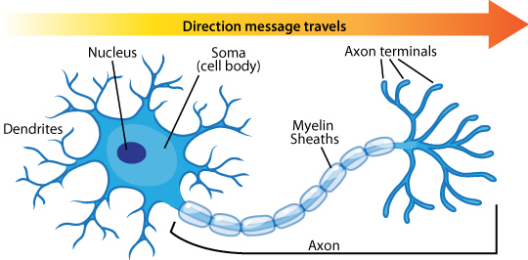
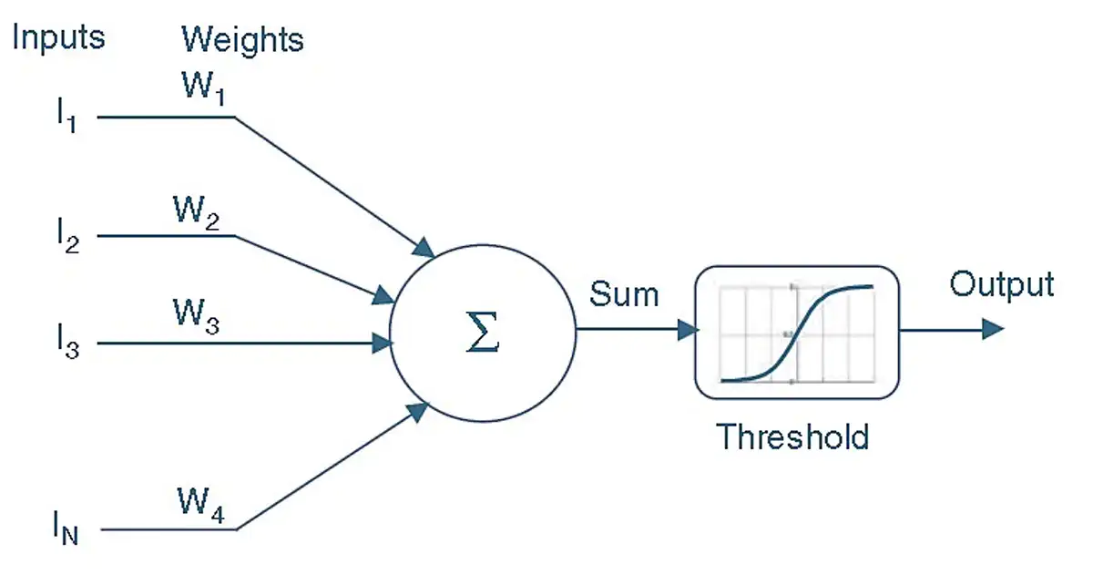
Biological Inspiration of an Artificial Neural Network (ANN)
Neuron
Artificial Neuron
Step
Direction of data flow
Linear
Rectified linear
Dendrons, are branched protoplasmic extensions of a nerve cell that propagate the electrochemical stimulation received from other neural cells to the cell body, or soma, of the neuron from which the dendrites project.
Neurons, propagate a set of input values, which are multiplied by weights and then aggregated. This sum is invariably passed through an activation function, or threshold function, f_{x}, and presented as the output.

Slide 8

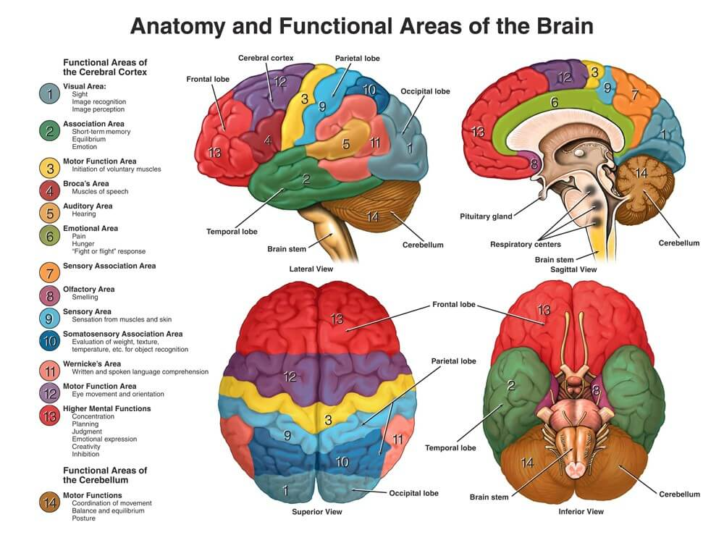

Slide 9

Feedforward Network
Rectified Linear (RELU)
4
0.5
(4*0.5=2) + (-1*2=-2) + (1*0.5=0) = 0.5 → 0.5
0.1
0.5
2
-1
-0.5
(0.5*0.5 →0.25) + (0*2 →0) = 0.25
2
0.5
(4*0.1=0.4) + (-1*-0.5=0.5) + (1*-2=-2) = -1.1 → 0
1
-2
Input Layer
Hidden Layer
Output Layer

Slide 10
Feedforward Network
Rectified Linear (RELU)
1
0.5
(1*0.5=0.5) + (2*2=4) + (3*0.5=1.5) = 6 → 6
0.1
0.5
2
2
-0.5
(6*0.5=3) + (0*2=0) = 3 → 3
2
0.5
(1*0.1=0.1) + (2*-0.5=-1) + (3*-2=-6) = -6.9 → 0
3
-2
Input Layer
Hidden Layer
Output Layer

Slide 11
Feedforward Network
Rectified Linear (RELU)
1
0.5
(1*0.5=0.5) + (2*2=4) + (3*0.5=1.5) = 6 → 6
0.1
0.2
2
2
-0.5
(6*0.2=1.2) + (0*4=0) = 1.2 → 1.2
4
0.5
(1*0.1=0.1) + (2*-0.5=-1) + (3*-2=-6) = -6.9 → 0
3
-2
Input Layer
Hidden Layer
Output Layer

Slide 12
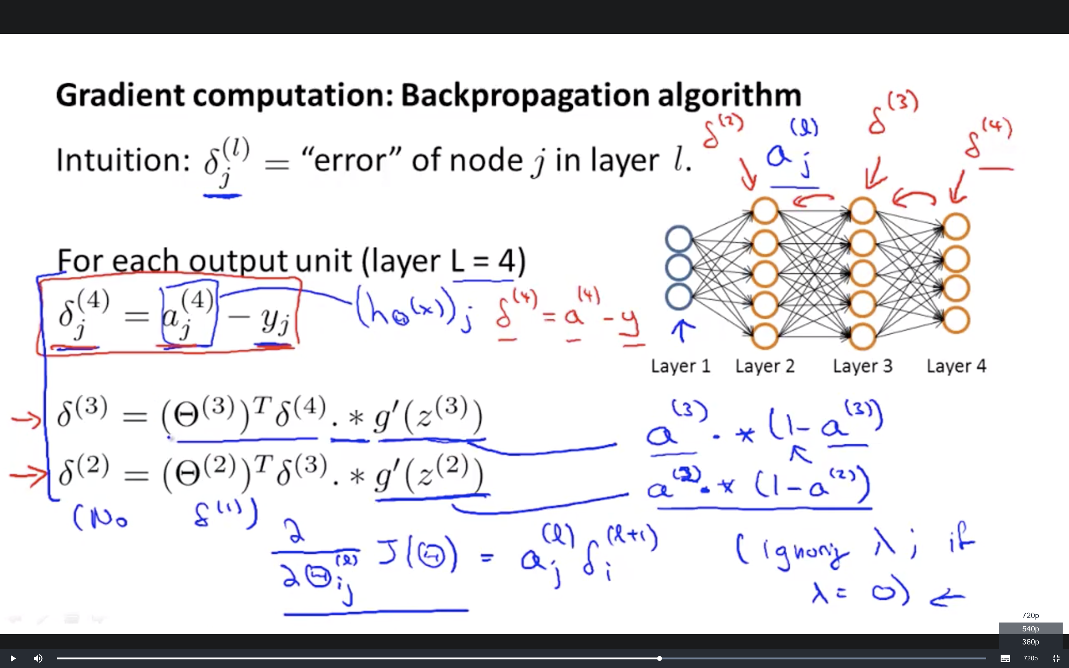
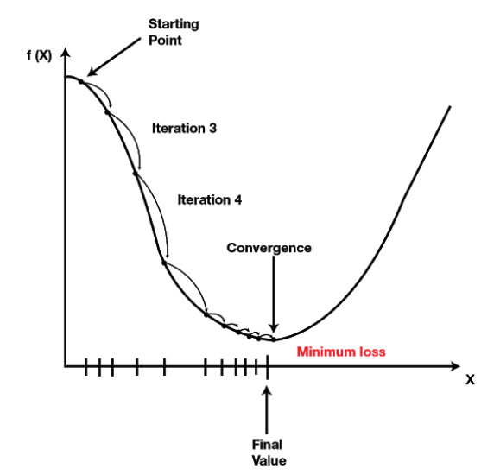
Training your DragonNeural Network – Backpropagation of Errors

Slide 13
Video
AI explained: How machine learning could save our healthcare system
https://www.youtube.com/watch?v=EuSt9l7EdiU

Slide 14

Wisconsin Diagnostic Breast Cancer Dataset
Released as a dataset for ML engineers to work on in 1995
Real data (rather than synthetic) – 569 instances 30 features* are computed from a digitized image of a fine needle aspirate (FNA) of a breast mass. They describe characteristics of the cell nuclei present in the image (patient ID and diagnosis label = 32 attributes)
Very widely used as an undergraduate level learning dataset
This is thus a classification problem – does a patient with breast cancer have a malignant tumor or a benign one?
* This would have been a HUGE dataset back then, now it’s quite (very) small

Slide 15
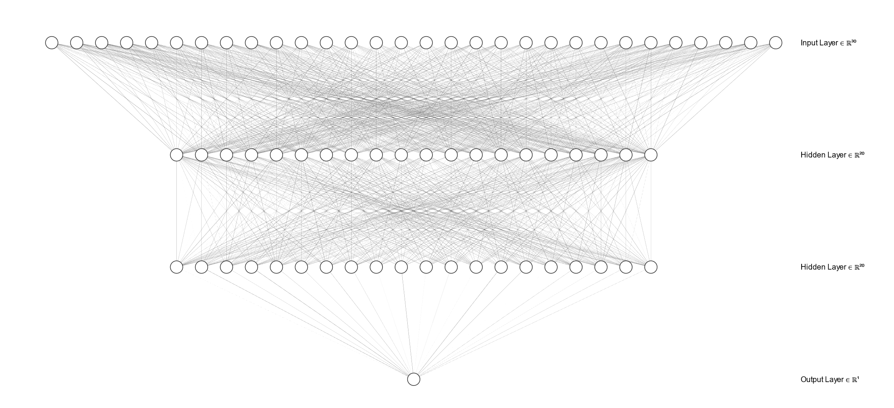
The model that was built…
The model that I built…

Slide 16
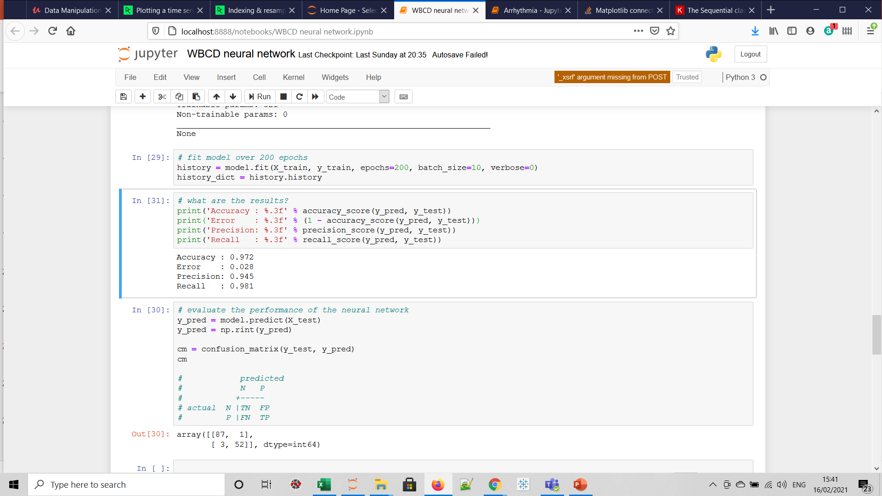
Accuracy score
Confusion matrix - how many did we get of each category:
True negative – are negative AND predicted negative
True positive – are positive AND predicted positive
False negative – are positive BUT predicted negative
False positive – are negative BUT predicted positive

Slide 17
ML coming to an ED near you?
Abirami Kirubarajan MSc Ahmed Taher MD, MPH Shawn Khan BHSc Sameer Masood MD, MPH
Artificial intelligence in emergency medicine: A scoping review, Journal of American College of Emergency Physicians, 2020

Slide 18

Thank you

Slide 19
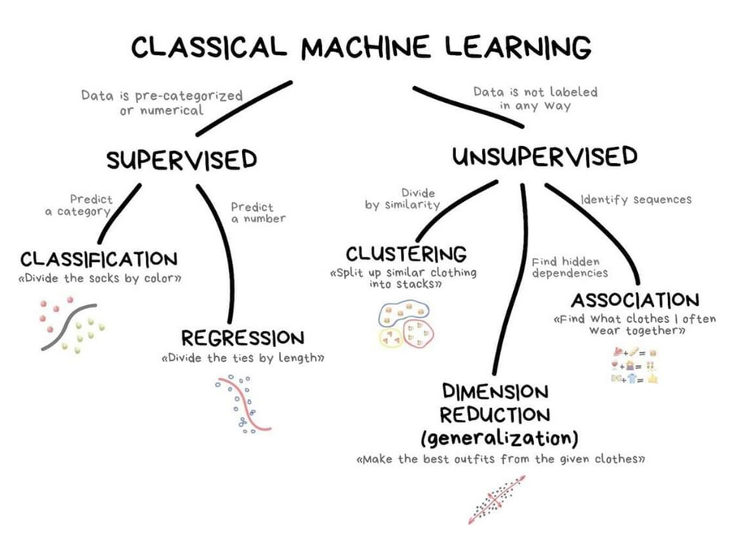
TAUGHT
DISCOVERY
Source:
https://vas3k.com/blog/machine_learning/

